Slide 1
CoE Database
Sprint 1
Ethan Busby, Marcus Kelley, Andy Fancher, Brodye Stevens, Jacob Santos
Project Website - https://coe-alumni-db-cs495.github.io/
Source Code Website - local for now

Slide 2

Project Overview
Database for Connecting Alumni
  Finding Jobs
  Recruiting
  Socializing
Responsive Website
  Relational Database
    Filter System
  Login Security
Notes:
Jacob

Slide 3
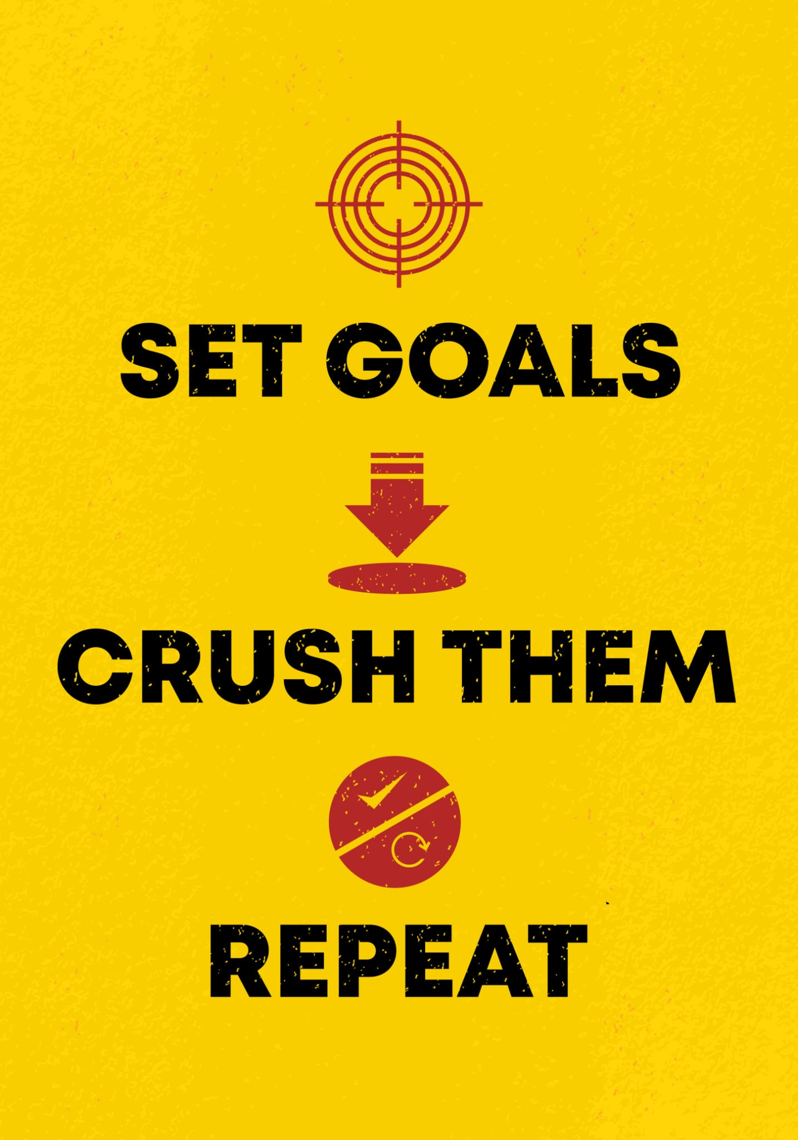
Sprint Goals
Set up Repo & Create Project
Create and Setup Relational Database (SQLite)
Create Responsive Navigation Bar
Create and Populate the 4 Pages Required:
  Home
  Profile
  Networking
  Favorites
Add Settings Page
Allow Users to Register & Sign In
Notes:
Andy

Slide 4
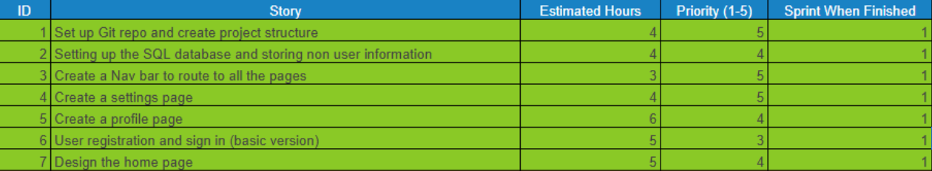
Sprint/Project Backlog
Notes:
Marcus

Slide 5
Major Achievements
Andy
  Created robust Profile Page that splits the user’s information into 3 distinct categories
  Allows the user to edit their profile and show updated information after saving
Ethan
  Created a responsive navbar linking to all pages
  Worked on creating basic login/register functionality
Jacob
  Helped design relational database with Brodye
  Developed python scripts for Odata collection through RESTful api
Brodye
  Designed the schema for the relational database with Jacob
  Made schematic changes to enable suggestions by our cybersecurity team
Marcus
  Designed the Home Page
  Designed Settings Page for the website.
Notes:
Each Member

Slide 6

Sprint Reflection and Sponsor Feedback
Sprint Reflection:
  We were not able to reach all of our goals for Sprint 1
  We had a major slowdown regarding server hosting, we are in an ongoing process resolving this
Sponsor Feedback:
  Our sponsor, Brinkley Wood, is happy with the progress so far
  The initial plan was to have a very soft launch at the end of the sprint, but she understands the roadblock with OIT server hosting
  We have needed to work hand in hand with her in the process of getting a server from OIT
  Much of our communication outside of this has been focused on details of the website itself, such as what fields to include and how to present it to the user
  We continue to be in close collaboration
Notes:
Brodye

Slide 7
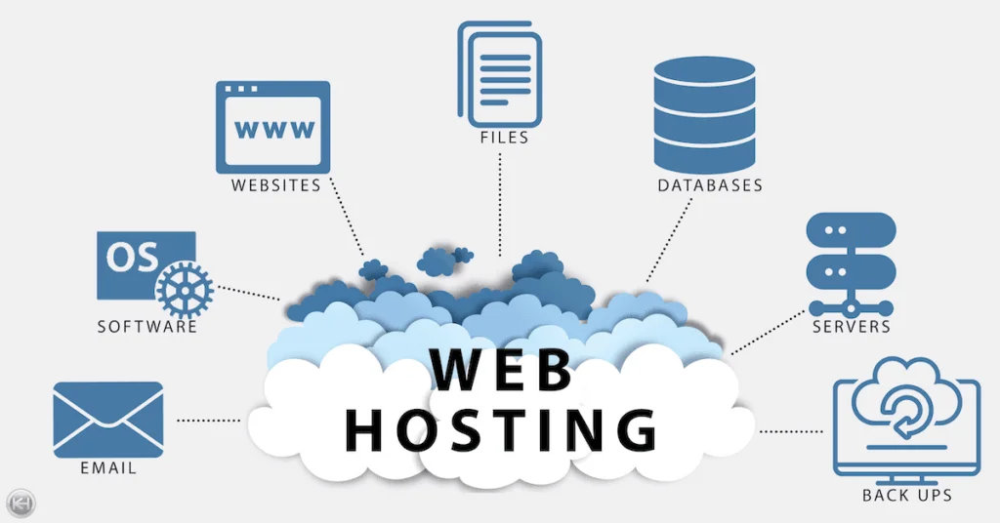
Not Completed/Lessons Learned
Not Completed
  Getting server for hosting
  Populating the networking and favorites pages
  Full login functionality
Lessons Learned
  Technical
    Using a code first approach to create the database
    Connecting our React frontend with the C#/.NET backend
    Separating public and private user information
  Non Technical
    Working with others outside of our original team
Notes:
Ethan

Slide 8
Demo Description
We will take a few moments to walk you through the project as it stands and demo each page that has been created.
Notes:
Andy -> Note: Do Settings Last

